Slide 1
Web Site www.mytesto.in / www.mytesto.co.in
Company - MYTESTO HEALTH PRIVATE LIMITED

Slide 2
Who are we?
Our technology platform connects customers and Lab partners to serve their multiple needs.
Customers use our platform to search and discover blood tests as well as other tests from preferred labs and schedule sample collection at home or the collection centres as per your convenience.
On the other hand, we provide Lab partners with industry-specific marketing tools which enable them to engage and acquire customers and grow their business while also providing a reliable and efficient last-mile sample collection service.
“MYTESTO” is an easy, efficient, accurate and trustworthy application for all your blood test/health check-up needs. We bring reliable, trustworthy and preferred pathology labs available to your doorstep.
Hassle-free online booking for sample collection at home and reports are also available online.
Get your test done today.

Slide 3
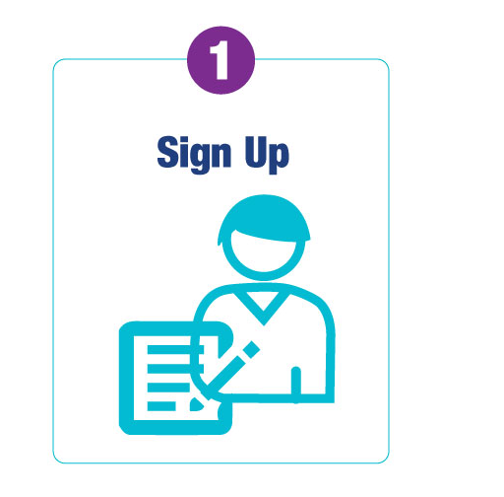
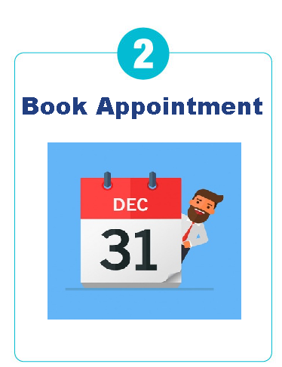
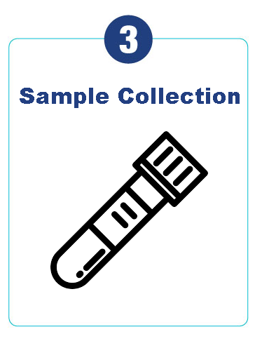
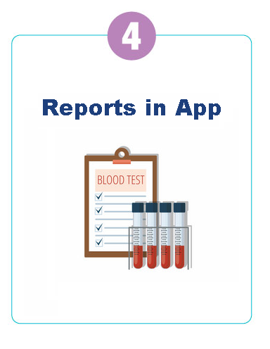
How It Works
Login/Sign Up
Book Test in nearest Lab
Sample Collection at doorstep
Reports in App

Slide 4
Why MYTESTO
“MYTESTO” is an easy, efficient, accurate and trustworthy application for all your blood test/health check-up needs. We bring reliable, trustworthy and preferred pathology labs available to your doorstep.
Hassle-free online booking for sample collection at home and reports are also available online.
Get your test done today.

Slide 5
How MYTESTO will help you to grow your business
We provide Lab partners with industry-specific marketing tools which enable them to engage and acquire customers to grow their business also will provide a reliable and efficient last mile sample collection service.
“MYTESTO” is easy, efficient, accurate and trustworthy application for all blood test booking, no need to have separate infrastructure for on line customer. We made pathology labs available at customer door step and all customer details to lab end therefore customer acquisition cost is nil by hospital or lab service provider .
Customers use our platform to search and discover blood test as well other test along with preferred labs as advised by treating doctors, customer book lab test from our application for sample collection at home as well as test at collection center and make payments while booking or after sample collection.

